Slide 1
Coronavirus (COVID19) & the workplace
Employee Wellness
Human Resources
March 2020

Slide 2

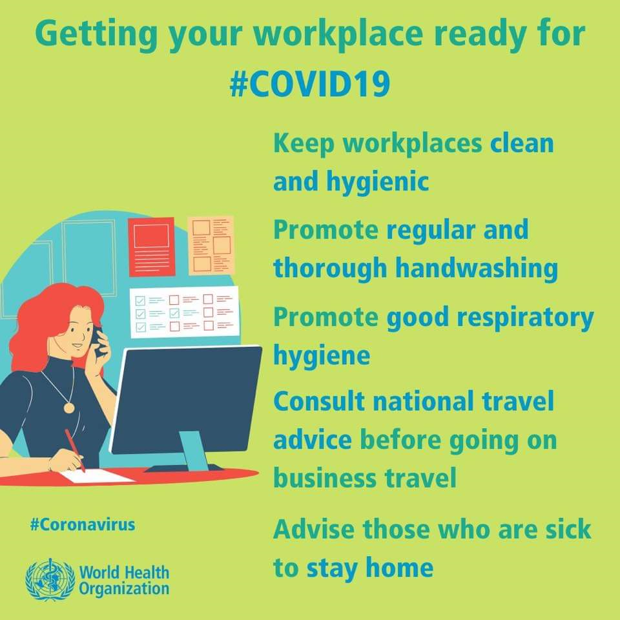

Slide 3
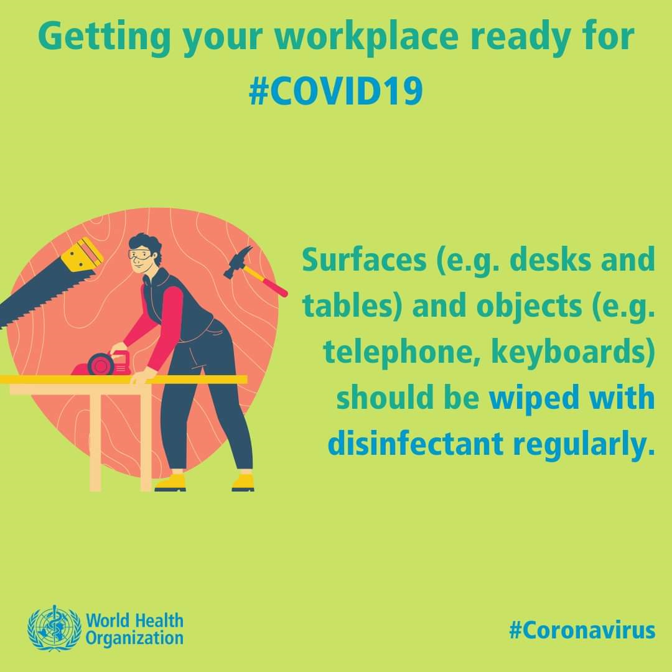

Slide 4
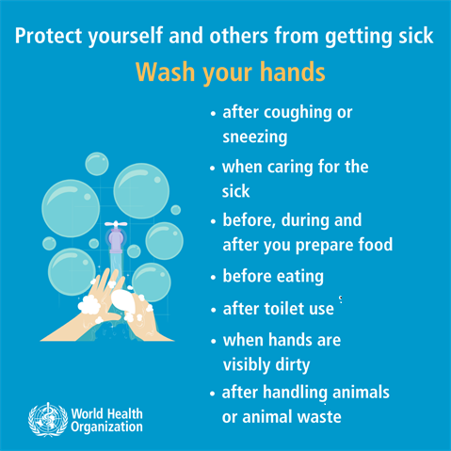


Slide 5
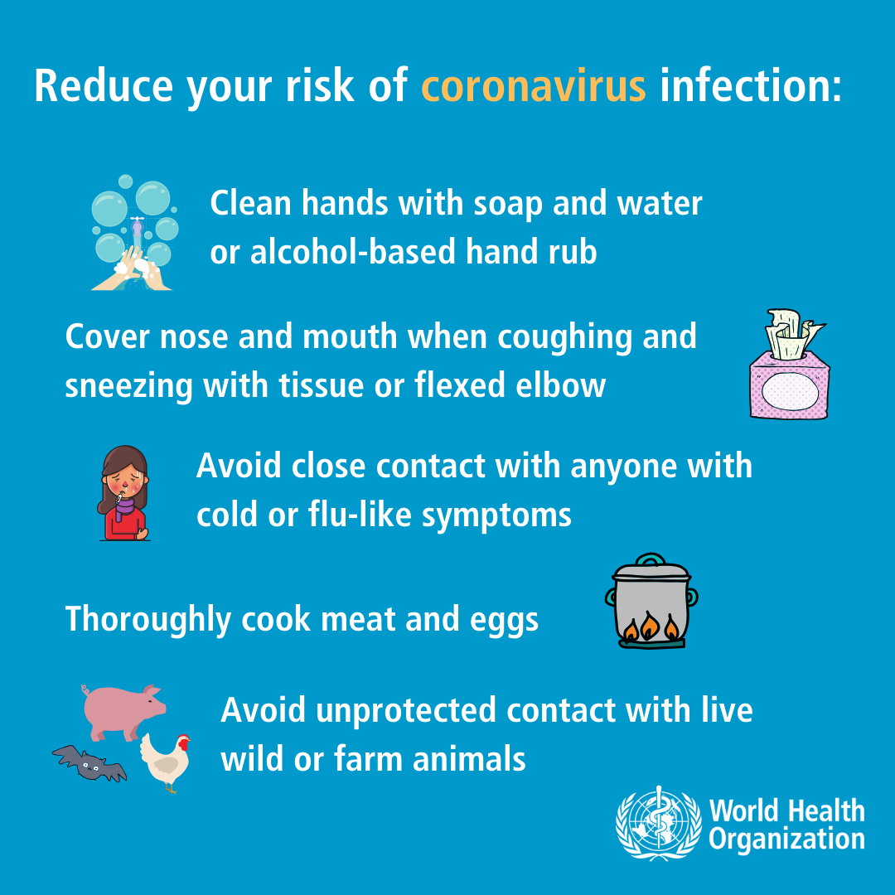

Slide 6
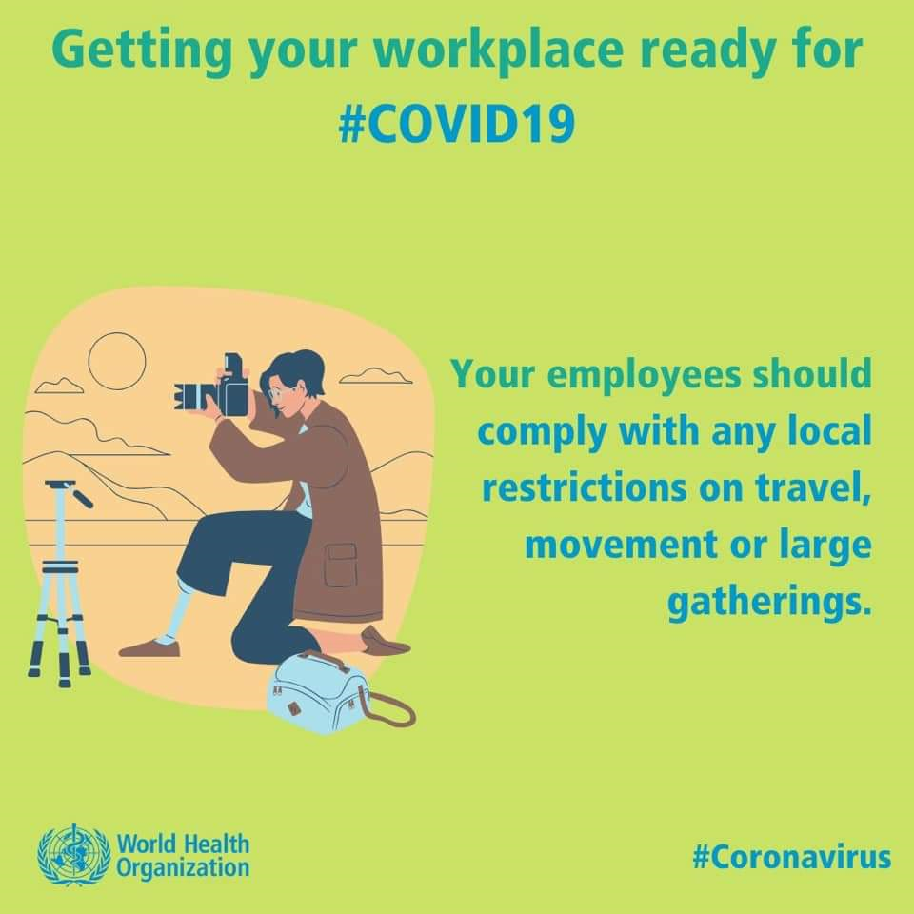


Slide 7
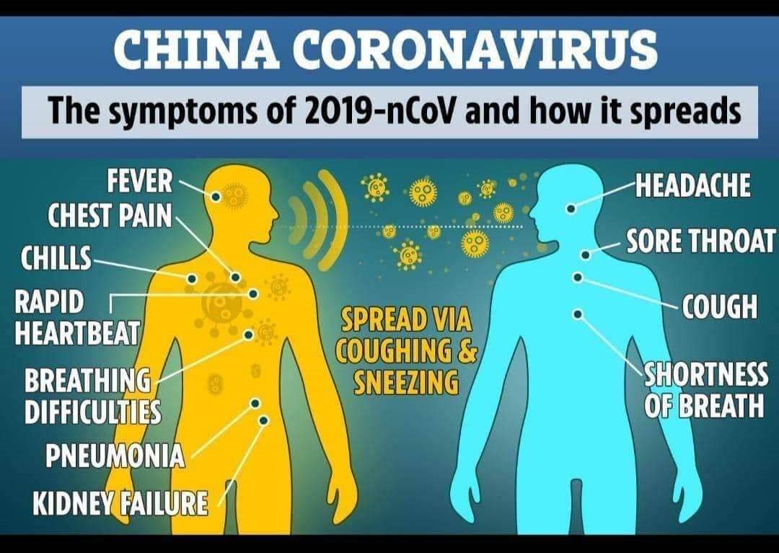

Slide 8
A reference guide
Patients with acute respiratory infection (sudden onset of at least one of the following: cough, sore throat, shortness of breath)
requiring hospitalisation or not
AND
In the 14 days prior to onset of symptoms, met at least one of the following epidemiological criteria:
• Were in close contact* with a confirmed or probable case of 2019-nCoV infection;
OR
• Had a history of travel to areas with presumed ongoing community transmission of 2019-nCoV; i.e. China
OR
• Worked in or attended a health care facility where patients with 2019-nCoV infections were being treated.

Slide 9
Coronavirus Hotline
0800029999

Slide 10
www.mandela.ac.za

